Slide 1
Lecture 6
18700714
Jamin andong

Slide 2
Attacks on enterprise networks
An attack is defined in a step-by-step approach in which several tasks are performed to gain access to an unauthorized domain/network
Attacks can be broken into:
Active attacks – Attacker actively tampers with data/messages from a remote location to the desired location
Passive attacks – Attacker monitors messages, passively eavesdrops

Slide 3
Network Monitoring: Attacker performs passive attacking in which they keep tabs on the network they intend to attack.
Information collection: Attacker gathers information of network and find vulnerabilities within it.
Attack planning: Attacker comes up with best strategy to launch an attack
Attack execution: Attacker finds where best to get access in network and executes attack where vulnerability was found
Trace clearance: Attacker attempts to clean up any evidence of an attack

Slide 4

Factors for carrying attack
Attacker motivation: This refers to how willing the attacker is to carry out the attack, some attacks may take enormous amounts of time to perform, ranging from high, medium, and low amounts of motivation.
Budget for attack: Some attacks are highly costly, and a fairly large amount of resources may be required. Enterprises with higher security will require a larger budget
Time to launch attack: While some attacks take time for passive attacks and eventual active attacks, an attacker needs to factor all steps on how they will attack and how long they will collectively take.
Increased personal reputation: An attacker may resolve to gain a higher amount of notoriety and will be more likely to carry out a high-level hack.

Slide 5
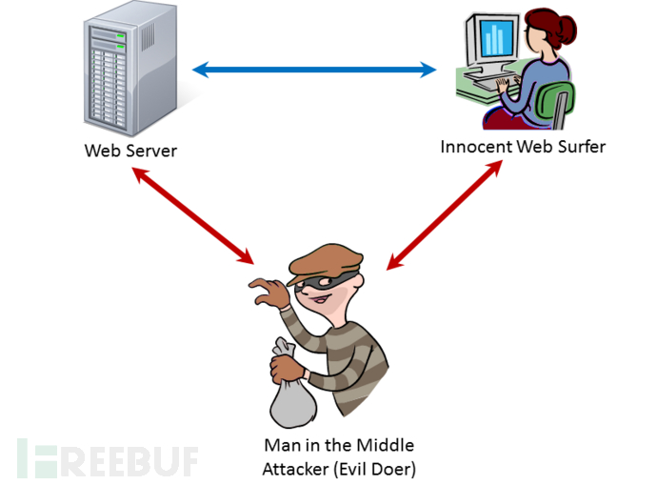
Man-in-the-middle attack
Man-in-the-middle attacks are involve having an attacker in between two enterprises, monitoring two enterprises that share data/information amongst themselves.
Broken into two modes:
Passive mode: Attacker monitors network with no manipulation of data
Attack mode: Attacker monitors network while manipulating data

Slide 6
Reflections
Attacks are about gathering information, working with available resources, and exploiting networks. Times to carry out attacks vary, and can range anywhere between a few months to years. Man-in-the-middle attacks are a particularly dangerous type of attack considering how much information is being sent and how sensitive it is. These attacks can still be avoided however, if both parties use strong encryption and use TLS certificates.

